Slide 1

Establishing & Sustaining Healthy Work Environments
Notes:
This presentation has been created for those looking to begin their journey to a healthier work environment. By providing background information about AACN's Healthy Work Environment Standards, your group can begin this work together or use the information provided here to help build a business case for implementing the standards. This presentation does not carry a copyright license and can be altered to fit the needs of your institution. AACN believes that solutions to the critical issues of inadequate staffing and the nurse shortage will not be successful or lasting unless the problem of unhealthy work environments is corrected. Creating healthy work environments in the hospital setting is imperative to improving patient safety as well as staff retention and recruitment. Negative, demoralizing and unsafe conditions in workplaces must not continue to put patients' lives at risk and hinder nurses' valuable contributions to the delivery of safe, effective, quality care.

Slide 2
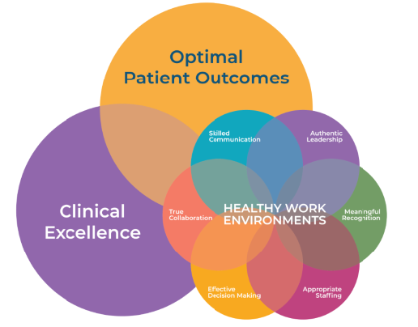
AACN’s Definition
Healthy Work Environments are….
Safe, healing, and humane
Respectful of the rights, responsibilities, needs, and contributions of all people…patients, their families, nurses, and all healthcare personnel
All members of the healthcare team can provide their optimal contribution and derive fulfillment from their work
Notes:
AACN defines a healthy work environment as a place that is “safe, healing and humane” and “respective of the rights and contributions of all.” It is “collaborative, patient focused and a place where nurses and healthcare professionals provide their optimal contribution toward high quality patient and family centered care.” At its core, a healthy work environment allows caregivers the time and resources to meet the needs of patients and families. This crucial component is what allows us to reconnect with the origin of our calling and is ultimately where we derive fulfillment from the work that we do.

Slide 3

AACN – Healthy Work Environment Journey
2024
2021
HWE National Collaborative
5th National Nurse Work Environment Survey
2005
2006
2008
2023
HWE Standards published
CSI HWE Cohorts
1st National Nurse Work Environment Survey
2nd National Nurse Work Environment Survey
2020
COVID-19 Pandemic
2002
2016
Committed to HWEs as a major advocacy priority
HWE Initiative Launched
HWE Standards 2nd edition
2013
2018
2001
3rd National Nurse Work Environment Survey
4th National Nurse Work Environment Survey
Notes:
In 2005 & 2016, AACN published the 1st and 2nd editions of the Standards for Establishing and Sustaining HWEs based on the mounting evidence that unhealthy work environments contribute to medical errors, ineffective care delivery, and conflict and stress among health care professionals and to assist organizations in achieving an HWE. AACN refers to this as the ‘blue book.’

Slide 4
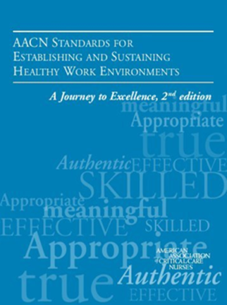
2005
Notes:
This seminal work identified 6 essential standards that must be in place to create and ensure an HWE. The standards provide an evidence-based framework for organizations to create work environments that encourage nurses and their colleagues in every healthcare profession to practice to their utmost potential, ensuring optimal patient outcomes and professional fulfillment. The standards uniquely identify previously discounted systemic behaviors that can result in unsafe conditions and obstruct the ability of individuals and organizations to achieve excellence. In this book, AACN calls for creating and continually fostering HWEs to ensure patient safety and optimal outcomes, enhance staff recruitment and retention, and maintain healthcare organizations’ financial viability.

Slide 5
AACN – Healthy Work Environment Journey
2021
5th National Nurse Work Environment Survey
2005
2006
2008
2025
HWE Standards published
1st National Nurse Work Environment Survey
2nd National Nurse Work Environment Survey
6th National Nurse Work Environment Survey
2002
2016
Committed to HWEs as a major advocacy priority
HWE Initiative Launched
HWE Standards 2nd edition
2013
2018
2001
3rd National Nurse Work Environment Survey
4th National Nurse Work Environment Survey
Notes:
In addition to publishing the standards, to further study our work environments, from 2006 to 2021, AACN conducted five national nurse work environment surveys. The sixth is in progress in 2025. Compelling evidence about the positive impact of HWEs was validated by the results from our surveys, especially the 2021 study, which reports a dramatic decline in the health of the work environment, along with a high number of nurses reporting a plan to leave their organizations.

Slide 6
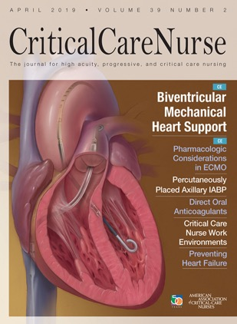
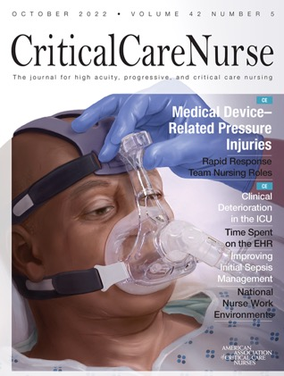
AACN’s National Surveys
2006
2008
2013
2018
2021
Notes:
These were large national surveys that increasingly extended beyond our critical care members. The survey focuses on all six standards, job satisfaction, and moral distress.
In the 2018 survey, AACN saw an upswing in the results. In 2021, amid the pandemic, AACN saw a major decline in all areas surrounding the health of the work environment. In 2021, over 10000 nurses participated in our survey, and over 9300 were eligible. Most were direct care nurses. Three areas of significant decline in Appropriate Staffing, Effective Decision Making, and Meaningful Recognition.

Slide 7
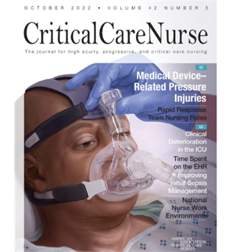
National Survey Data: October 2021
Fifth survey: Scores fell compared to 2018
Appropriate staffing score is the lowest across all five
Implementation of HWE standards makes a difference
Implementing even one standard reduces intent to leave
Ulrich B, Cassidy L, Barden C, et al. National nurse work environments – October 2021: a status report. Crit Care Nurse. 2022;42(5):58-70.
Notes:
AACN looked deeper at units that had started implementing the standards, even one. AACN found significant improvements in those areas of Appropriate Staffing, Effective Decision Making, and Meaningful Recognition. Another new concerning development in the 2021 survey was the satisfaction of nurses with their jobs and with their profession. BOTH of those areas dropped. Prior studies reported that nurses were sometimes not so satisfied with their jobs, but were satisfied with their profession. In the 2021 survey, satisfaction with being a nurse dropped significantly from 93% to 60%. Additionally, there was a decline in whether nurses who would recommend nursing as a profession. Satisfaction with units that had implemented the standards versus those that had not, satisfaction was much higher in units that had implemented the standards.

Slide 8
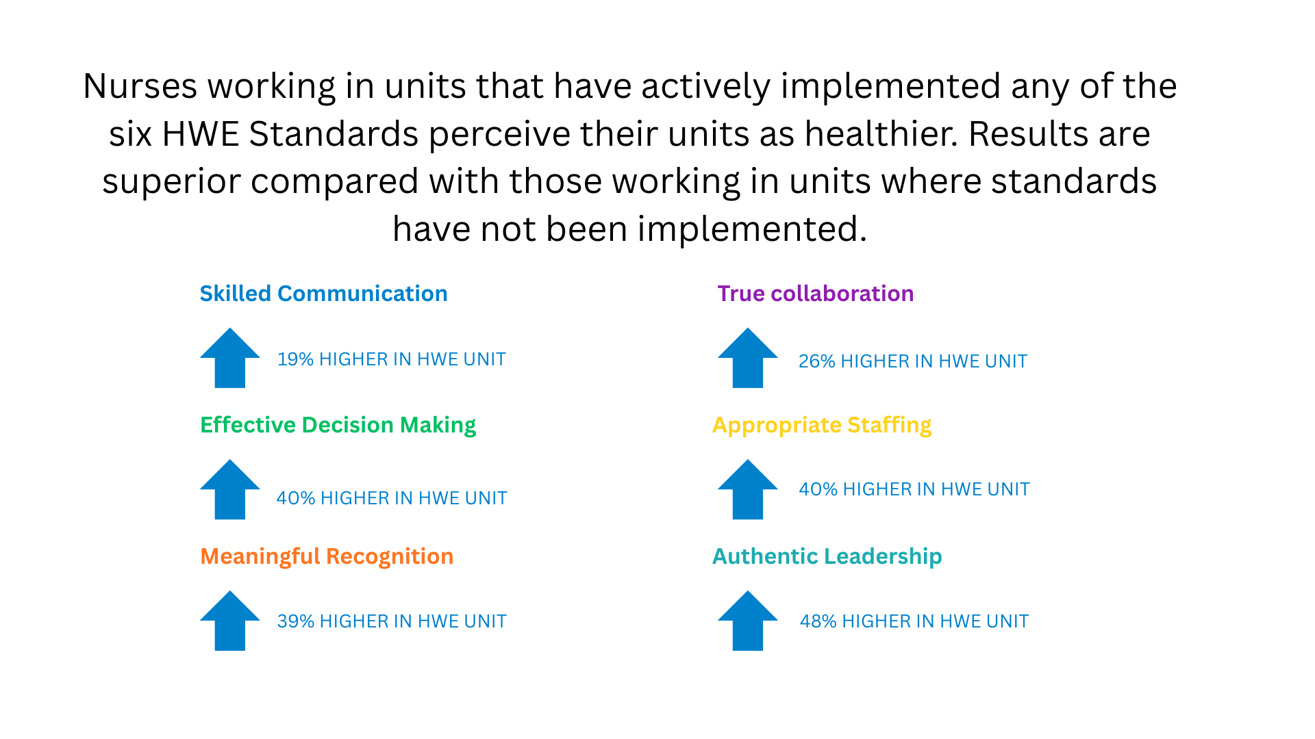
Ulrich B, Cassidy L, Barden C, et al. National nurse work environments – October 2021: a status report. Crit Care Nurse. 2022;42(5):58-70.
Notes:
When you examine the impact of healthy work environments on patients, you will find that healthy work environments are associated with less mortality, less failure to rescue, better survival from in-hospital cardiac arrest, and fewer hospital-acquired conditions. As a result of better quality care, patients are also better prepared for discharge and require fewer readmissions.

Slide 9
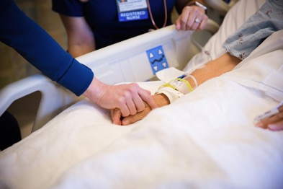
HWE & Patient Outcomes
↓ Mortality
↓ Failure to Rescue
↑ Survival from in-hospital CPA
↓ HACs (Falls, HAPI, CAUTI, CLABSI, etc.)
↓ Errors
↓ Delayed/missed/omitted care
↑ Prepared for D/C and care for self
↓ Readmissions
↑ Satisfaction with care
American Association of Critical-Care Nurses
Notes:
When you examine the impact of healthy work environments on patients, you will find that healthy work environments are associated with less mortality, less failure to rescue, better survival from in-hospital cardiac arrest, and fewer hospital-acquired conditions. As a result of better quality care, patients are also better prepared for discharge and require fewer readmissions.

Slide 10
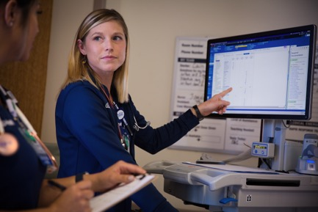
HWE & Nurse/Healthcare Team Outcomes
↓ Burnout
↓ Fatigue
↓ Turnover
↑ Engagement
↑ Retention
↑ Fulfillment
American Association of Critical-Care Nurses
Notes:
HWEs also impact nurses! Nurses who work in healthy work environments perceive less missed or delayed patient care, which contributes to less burnout, fatigue, and moral distress, and all of these factors lead to improved job satisfaction, better retention rates, and less nurse turnover.
Kester et al. (2021)

Slide 11
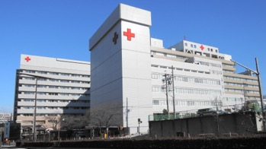
HWE & Hospital Outcomes
↓ Turnover
↑ Retention
↑ Quality outcomes
↑ Revenue
↑ Patient satisfaction
↑ Patient referrals (recommend the hospital to others)
↑ Patient volumes
This Photo by Unknown Author is licensed under CC BY-SA
Notes:
Patients cared for in HWEs experience fewer adverse events, report greater satisfaction with their care, are better prepared for discharge, and are likelier to recommend hospitals to their family members and friends for care. HWEs impact quality and can also lead to higher reimbursement rates. Greater patient satisfaction typically leads to better business, and improved retention requires less time and resources addressing nurse turnover. The link between HWEs and positive patient, nurse, and organizational outcomes has become clear. The health of the work environment is essential for optimal patient care and a sustainable healthcare provider workforce. However, HWEs do not spontaneously happen. Focused attention and deliberate strategies are necessary to ensure their creation and evolution.
Kester et al. (2021)

Slide 12
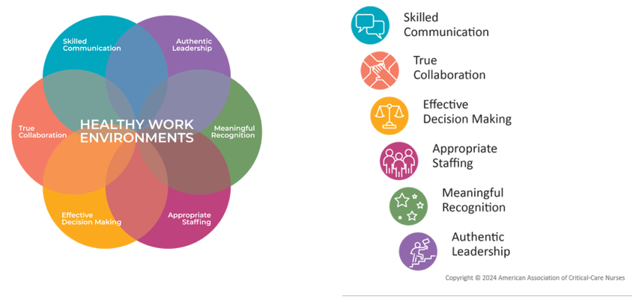
AACN Six Standards for Establishing and Sustaining Healthy Work Environments
Healthy Work Environment
Notes:
In response to growing concerns over workplace culture and staffing shortages, as well as mounting evidence that unhealthy work environments contribute to the ineffective delivery of care, conflict, and stress among healthcare workers, AACN has committed to developing standards for improving interprofessional collaboration and effective leadership, which are essential to healthy workplace environments. In doing so, a panel of 9 people convened and drew from published and unpublished reports from nurses across the US. The standards were then carefully crafted and strategically aligned with core competencies and recommendations from the Institute of Medicine (now the National Academy of Medicine) and the Robert Wood Executive Nurse Fellows Program. With guidance that focused on implementing evidence-based practices and quality improvement strategies to deliver high-quality care while supporting opportunities to cultivate strategic vision, risk-taking, and self-knowledge in nursing leaders and staff. 50 expert reviewers then validated the standards and critical elements to ensure each was evidence-based. The standards are reviewed and updated periodically as new evidence emerges to ensure the most up-to-date information is available to the nursing community.
The standards represent evidence-based and relationship-centered principles of professional performance. Each standard is essential in that effective and sustainable outcomes do not emerge when any standard is considered optional. Looking at the diagram illustrated here, you can see the interdependence of each standard. The standards are neither detailed nor exhaustive, but with these standards, we aspire to shine a light on the dimension other frameworks often overlook — the human factor. The standards provide a functional yardstick for the performance and development of individuals, units, organizations, and systems. They reaffirm that safe and respectful work environments are imperative and require systems, structures, and cultures that support all the standards. Implementation of the standards also demonstrates an organization’s ethical accountability for the provision of safe and optimal care to patients and families. The standards can only lead to excellence when they have been adopted at every level of the organization — from the bedside to the boardroom.

Slide 13
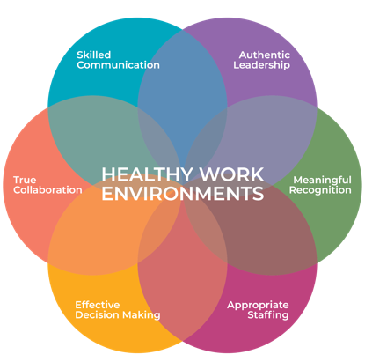
Skilled Communication
Be as proficient in communication skills as you are in clinical skills
Notes:
Nurses must be as skilled in communicating as we are in our clinical skills. Skilled communication can save lives. Promoting open and effective conversation among team members optimizes patient outcomes and encourages essential collaboration.

Slide 14

Skilled Communication
Team members
Words = Action
Continually improve skills
Hear all perspectives
Build consensus
American Association of Critical-Care Nurses
Notes:
Skilled communication is more than just how we talk to each other. So, how do nurses and their colleagues become skilled communicators? Skilled communication requires soliciting feedback and performing a self-assessment to better understand personal communication skills. In addition, nurses must be willing to have candid, direct conversations with each other to address unhealthy communication practices. Skilled communicators demonstrate congruence between their words and actions and hold others accountable for doing the same. They listen to all perspectives, find solutions, build consensus, and achieve desirable outcomes.

Slide 15
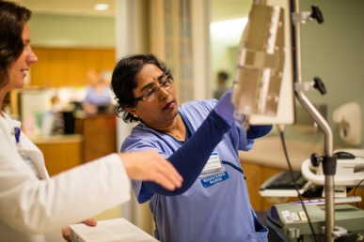
Skilled Communication
Organizations
Provide support, education, and coaching
Establish zero-tolerance policies
Develop formal structures/process
Include in performance appraisals
American Association of Critical-Care Nurses
Notes:
Organizational factors that contribute to a culture of silence include a lack of confidence, fear of personal implication, fear of retaliation, intimidating behaviors, and microclimates of distrust. Organizations must: provide team members with interprofessional education and coaching that develop critical communication skills; establish zero-tolerance policies and enforce them to address and eliminate workplace abuse and other disrespectful behavior; establish formal structures that ensure effective and respectful information sharing among patients, families, and the healthcare team; and include communication as a criterion in its formal performance appraisal system. Since the true price of failed communication is not measured in dollars but in lives lost, all nurses have an ethical mandate to overcome these challenges and become skilled communicators. Patients’ lives depend on it.

Slide 16
True Collaboration
Be relentless in pursuing and fostering true collaboration
Notes:
Collaboration between diverse team members is complex and essential to optimal patient care. That is why we must be relentless in our pursuit of true collaboration.

Slide 17
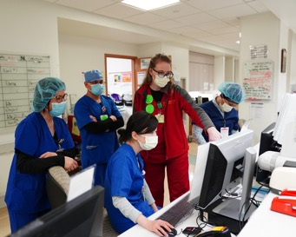
True Collaboration
Team Members
Embrace ongoing process of mutual trust and respect
All disciplines are equal partners
All foster true collaboration
American Association of Critical-Care Nurses
Notes:
Skilled communication is an essential element of True Collaboration. Without effective communication, effective collaboration cannot exist. Have you ever heard “A team that works together succeeds together”? Maintenance of mutual respect, a balance of the distribution of power, and a focus on common goals are elements that facilitate collaboration. No matter who is involved, collaboration is not possible until mutual understanding and an equal distribution of power exist among all individuals involved. Mutual understanding is best achieved when personal titles and biases are set aside and common goals become the focus.

Slide 18

True Collaboration
Organizations
Provide support/access to interprofessional education/coaching
Create structures that ensure all have a seat at the table
American Association of Critical-Care Nurses
Notes:
True collaboration is an ongoing process that builds over time with support and coaching, eventually resulting in a work culture where communication and decision-making between nurses and other professionals become the norm. Without the synchronous, ongoing collaborative work of healthcare professionals from multiple disciplines, patient and family needs cannot be optimally satisfied within the complexities of today’s healthcare system. Collaboration requires that everyone has a seat at the table.

Slide 19


Skilled Communication
True Collaboration
↑ Patient safety
↑ Quality of care
↑ Patient outcomes
↑ Nurse satisfaction
↑ Interprofessional relationships
↓ Calculated risks
↑ Empowerment of nurses
↑ Patient safety
↑ Quality of care
↑ Nurse satisfaction
↑ Patient outcomes
↑ Interprofessional relationships
↓ Mortality
What We Know
HWE Standards
Notes:
By implementing the Skilled Communication Standard, departments tend to see improved patient safety, quality care, and patient outcomes. They also see higher levels of nurse satisfaction, improved interprofessional relationships, and a decrease in calculated risks since nurses are more likely to speak up and ask questions. With True Collaboration come many of the same changes just described, along with improved nurse empowerment and decreased mortality rates.

Slide 20
Effective Decision-Making
Be committed partners in making policy, directing and evaluating clinical care, and leading organizational operations
Notes:
Nurses must be valued and committed partners in making policy, directing and evaluating clinical care, and leading organizational operations.

Slide 21

Effective Decision-Making
Team members
Share accountability
Acquire necessary skills
Actively inquire
American Association of Critical-Care Nurses
Notes:
Improving patient care starts with empowering the people who care for those patients. When nurses sit at the table alongside other healthcare professionals and organization leaders, we can design protocols that benefit both team members and patients. Optimal outcomes and greater job satisfaction are more likely when nurses actively influence decisions that impact the quality of patient care. Nurses share accountability for effective decision-making by acquiring necessary skills, sharing fact-based information, communicating opinions clearly, and inquiring actively.

Slide 22

Effective Decision-Making
Organizations
Articulate organizational values
Provide support/education for programs
Include patient/family perspectives
American Association of Critical-Care Nurses
Notes:
The healthcare organization must clearly articulate organizational values and ensure that nurses are in positions to participate in all levels of decision-making, incorporating these values when making decisions, and have operational structures in place that ensure the perspectives of patients and their families are incorporated into decisions affecting patient care. Shared governance is another approach to effective decision-making. Shared governance uses the expertise of nurses and other members of the healthcare team to influence the decisions that affect care delivery. In this process, the responsibility for practice-related decisions lies with those who deliver care, which increases professional autonomy

Slide 23
Appropriate Staffing
Staffing must ensure the effective match between patient needs and nurse competencies
Notes:
Appropriate staffing is so much more than numbers. Appropriate staffing is clearly linked to the health of your work environment, and it affects everything in your unit, including nurse performance and retention, quality of care, patient outcomes, and hospital costs. Appropriate staffing is a complex process. The goal is to match the knowledge, skills, and abilities of the nurse with the needs of the patient. Effective innovation in staffing goes beyond fixed ratios and ensures the voice of direct care nurses in staffing decisions.

Slide 24

Appropriate Staffing
Team members
Nurse competencies match patient needs
Participate in staffing process
Education
Planning
Evaluation
American Association of Critical-Care Nurses
Notes:
The inclusion of direct-care team members is essential in developing new approaches to nurse staffing. Unit-based and organization-wide staffing committees with the authority to develop processes and make decisions about nurse staffing procedures must include direct care nurses. Team members should participate in all organizational phases of the staffing process from education and planning, selection and evaluation of technologies, including matching nurses’ competencies with patients’ assessed needs, through evaluation.

Slide 25
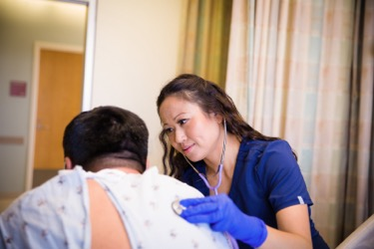
Appropriate Staffing
Organization
Formal process to evaluate staffing decisions
System to facilitate more effective staffing models
Ensure support for nurses
American Association of Critical-Care Nurses
Notes:
The healthcare organization must put into place a formal plan to evaluate the effect of staffing decisions on patient and system outcomes; have a system in place that facilitates team members’ use of staffing and outcomes data to develop more effective staffing models; and provide support services at every level to ensure nurses can optimally focus on the priorities and requirements of patient and family care.

Slide 26


Effective Decision Making
Appropriate Staffing
↑ RN job satisfaction, ↑ retention
↓ RN burnout & fatigue
↑ Patient satisfaction
↓ Patient readmissions
↓ Missed care
↓ Failure to rescue & mortality
↓ Hospital acquired conditions
↑ Accountability, autonomy and control over practice
↑ Identification of patient cues that prevent deterioration
↑ Quality of care
↑ Patient satisfaction
↓ Hospital acquired conditions
What We Know
HWE Standards
Notes:
With effective decision making, we see improved accountability, autonomy, and control over practice, a heightened awareness of cues that prevent patient deterioration, better quality of care and patient satisfaction, and fewer hospital-acquired conditions. When staffing is appropriate, there is higher job satisfaction and retention, better patient satisfaction with less missed care, failure to rescue, mortality, and hospital-acquired conditions.

Slide 27
Meaningful Recognition
Be recognized and recognize others for the value each brings to the work of the organization
Notes:
Meaningful recognition means valuing nurses for their unique contribution to patient care. The social and psychological impact of such recognition includes job satisfaction, organizational and career commitment, cohesion and collaboration, and perceived organizational support. Among respondents to our national survey, those who indicated an intent to leave their position within a year, 39% said that meaningful recognition would make them less likely to leave the organization. AACN’s research also clearly demonstrates that the recognition nurses receive from patients and families is most meaningful, closely followed by recognition from their peers.

Slide 28
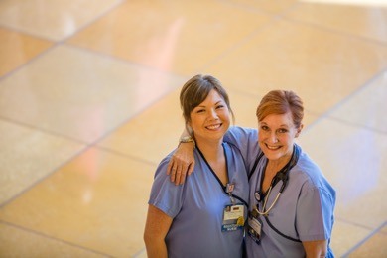
Meaningful Recognition
Team members
Everyone plays a role in recognizing meaningful contributions
American Association of Critical-Care Nurses
Notes:
Although nursing is one of the most rewarding professions, it can also be among the most challenging. The essence of meaningful recognition is to find ways to recognize nurses’ contributions on a routine basis. There are readily available ways to incorporate meaningful recognition into the daily practice of a unit or department. Verbal praise, handwritten notes, highlighting nurses in the unit’s newsletter, and bulletin boards displaying thank-you notes from patients, families, and colleagues are all well-received forms of recognition that are associated with very little cost. Team members must understand that everyone is responsible for playing an active role in the organization’s recognition program and providing meaningful recognition for all team members’ contributions, not just formal leaders.

Slide 29
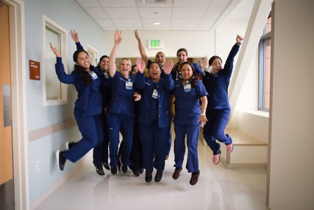
Meaningful Recognition
Organization
Process/Program for recognizing members
All team members know about the program
American Association of Critical-Care Nurses
Notes:
Organizations should have systems in place to recognize nurses in an individualized and meaningful way to help provide a well-deserved honor and enhance a sense of value, leading to greater fulfillment. More formal strategies for demonstrating meaningful recognition include support for certification, clinical ladder programs, and the DAISY Award, which provides patients and families with a path to convey appreciation for nurses. Unit- and organizational-level recognition can be achieved through programs such as the AACN Beacon Award for Excellence.

Slide 30
Authentic Leadership
Fully embrace the imperative of a healthy work environment, authentically live it and engage others in its achievement
Notes:
Leaders, both formal and informal, create the culture of the work unit and organization. Authentic leaders are role models. They build a sense of connectedness in the work unit. With patient outcomes as the focal point, authentic leaders help the healthcare team maintain a sense of meaning in their work. High levels of behavioral integrity exhibited by authentic leaders promote commitment and trust among followers. Without authentic and engaged leaders, an HWE will not exist.

Slide 31

Authentic Leadership
Team members
Role model the standards
Design systems that effectively implement/sustain HWE standards
American Association of Critical-Care Nurses
Notes:
A good leader sets the tone for the unit. AACN’s research shows that healthy work environments are much more likely to have nurse leaders who fully embrace the six HWE standards. Authentic leadership also equips nurses with the skills and encouragement they need to grow in their practice. The result is a more knowledgeable, cohesive unit that consistently elevates patient care. Team members must role model all the standards and display leadership and enthusiasm in creating and sustaining healthy work environments. Authentic leaders are not flawless, but they are consistent. They develop processes to sort and accept feedback and grow from challenges.

Slide 32

Authentic Leadership
Organizations
Ensure leaders develop/enhance knowledge in all six standards
Develops formal mentoring programs
Include HWE standards in annual performance appraisal
American Association of Critical-Care Nurses
Notes:
The healthcare organization provides support, education, and coaching to ensure that nurse leaders develop and enhance knowledge and abilities in all of the 6 HWE standards; develops a formal mentoring program for all nurse leaders to foster the mentorship of nurses in all roles and levels of experience; and includes the HWE standards as a criterion in each nurse leader’s performance appraisal.

Slide 33


Meaningful Recognition
Authentic Leadership
Recognition from patient, families and peers is important
Impact of nursing stories strengthen nurses voice
Role delineation – value of nurses and all team members
Lack of meaningful recognition can lead to:
Discontent
Compassion fatigue
Burnout
Nurses perceive a higher quality of care
↓ Burnout
↑ Patient satisfaction
↓ Medical errors
↓ Hospital acquired conditions
↓ Mortality
What We Know
HWE Standards
Notes:
Research exploring nurse recognition reveals that nurses rate recognition from their patients and families as most important, followed by their colleagues and nurse managers. Nursing stories, for example, about recognition tend to strengthen our voices and showcase the value of each team member. On the contrary, a lack of meaningful recognition often leads to discontent, compassion fatigue, and burnout. Those who exhibit characteristics of authentic leadership tend to have a “trickle-down" effect. Nurses who work alongside authentic leaders perceive a higher quality of care and experience less burnout on average. Patients in those units tend to report higher satisfaction levels and experience fewer medical errors and hospital-acquired conditions that can lead to mortality.

Slide 34
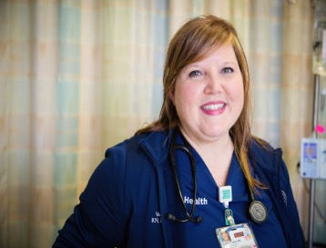
Begin in the Mirror
“I'm starting with the man in the mirror, I'm asking him to change his ways; And no message could have been any clearer, If you wanna make the world a better place, Take a look at yourself, and then make a change!”
--Michael Jackson
American Association of Critical-Care Nurses
Jackson, M. (1988). Man in the Mirror [Recorded by Michael Jackson]. On Dad [CD]. Epic Records.

Slide 35
What can I do?
Assess: Think about your words and actions in the context of the six Healthy Work Environment Standards.
Apply: The next time you face a challenging interaction or situation, consider the Standards as a framework.
Advocate: Use AACN’s Creating HWEs Toolkit and the ROI (return on investment tool) to build a case with peers and colleagues for implementing the standards.

Slide 36
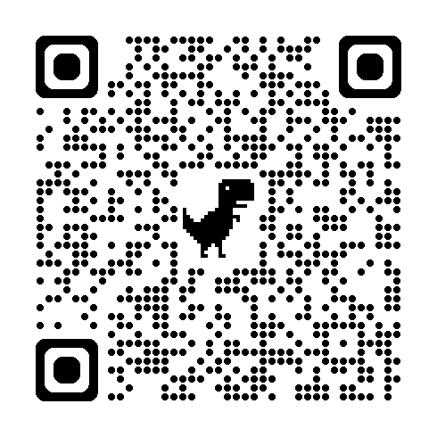
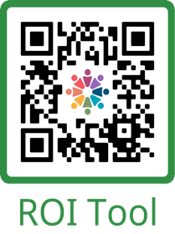
Toolkit and Return on Investment Tool
Creating HWEs Toolkit

Slide 37
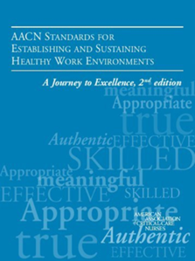
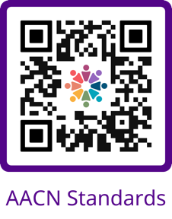
AACN’s Healthy Work Environment Resources
Hyperlinks to pages for each of the six standards and additional resources
Downloadable PDF of the Standards
HWEAT Healthy Work Environment Assessment Tool
Creating HWEs Toolkit

Slide 38







AACN Healthy Work Environment Assessment
24-question web-based assessment
Confidential & Anonymous
American Association of Critical-Care Nurses
Only takes 10 minutes to complete
AACN provides a summary result
Evaluates the work environment based on the 6 HWE Standards
Overall HWE Score
Score based on each standard
Provides a place to start
It's FREE!
www.aacn.org/hwe
Notes:
If you are ready to take the first step, begin with a free assessment of your work environment using AACN's Healthy Work Environment Assessment Tool (HWEAT). Here you will find an anonymous, 24-item questionnaire that takes less than 10 minutes to complete. This assessment measures baseline and sequential progress of a unit’s journey to implement and sustain the standards. The results from this tool can be used in conjunction with the National Database of Nursing Quality Indicators and staff engagement surveys to guide work environment improvement efforts. Setting up the assessment for your team is easy! Log onto the website provided, fill out the required information, and set a survey window. Send the survey link to your colleagues, then check back in when the survey window closes for your report and a benchmark report for comparison. Gathering baseline information from this helps identify important strengths and opportunities for growth, while giving you a starting point for process improvement initiatives and a method to track progress and build a plan for sustainment. Reviewing and discussing your results with your department and leaders regularly is key to building an HWE and culture. There are also references and other resources that support individuals and teams in understanding perceptions, barriers, and tactics for addressing each standard.

Slide 39
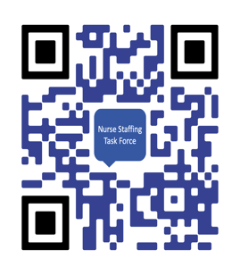
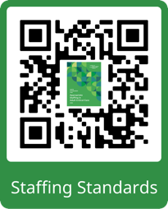
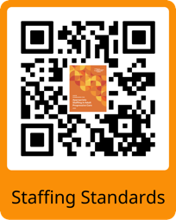
Want to learn more about staffing? Use these resources
Notes:
https://www.aacn.org/clinical-resources/staffing
https://www.aacn.org/nursing-excellence/healthy-work-environments
https://www.aacn.org/nursing-excellence/standards/aacn-standards-for-appropriate-staffing-in-adult-critical-care
https://www.aacn.org/nursing-excellence/standards/aacn-standards-for-appropriate-staffing-in-adult-progressive-care

Slide 40
Take Home Message
There is a direct link between the work environment, patient safety, and optimal outcomes. Therefore, if we are not addressing our work environment, we are not addressing patient safety.
Healthy work environments do not just happen. Therefore, little will change if there is no focused effort on addressing work environment issues.
Creating HWEs requires changing long-standing cultures, traditions, and hierarchies. Therefore, everyone must be involved in the creation of healthy work environments.
Implementation matters!
Notes:
Over the past two decades, investigators have been gathering evidence on the impact of nurse work environments. From these efforts, we now acknowledge 3 basic assertions about HWE.
#1: Since there is a direct link between work environment, patient safety, and optimal outcomes, if we are not addressing our work environment, then we are not addressing patient safety.
#2: We have learned that HWEs do not just happen. Creating them requires a focused and sustained effort. Without this, little will change.
#3: Creating an HWE requires us to challenge long-standing cultures, traditions, and hierarchies. Changing these practices requires EVERYONE to be involved, and each of us has an important role to play.
It is clear from the evidence that healthy work environments are not optional. They are as important as clinical competence and expertise. Healthy work environments are essential to foster optimal outcomes for patients, their families, the healthcare team, and the viability of healthcare organizations. However, healthy work environments do not happen spontaneously. They take time, focused intention, and a dedicated action plan. The process must be in constant evolution to achieve and sustain success. Change takes time, patience, and the shared vision of committed individuals. Healthy work environments are worth the effort because the lives of patients and the well-being of the healthcare team depend on them.

Slide 41
A Healthy Work Environment is an ongoing journey that involves ongoing growth and evolution….there is no finish line!
Assess
Discuss (What, Why, Who, and How)
Develop a plan
Take action
Reassess
Evolve
Spread/sustain
Notes:
Start with a self-assessment. Take an honest look at your contribution to the work environment as a key exercise in thinking about the journey forward. Engage team members to consider how the work environment impacts their practice. Review the HWE standards and their associated critical elements on our website and in the blue book. Discuss the evidence that supports each standard and its impact on healthcare delivery. Complete a focused assessment using the HWEAT to determine the current health of your work environment. Develop an action plan. You might start with a specific standard based on the assessment results. Develop and implement strategies for change. Implement an ongoing system to monitor the health of the work environment to ensure progress and sustainability. Those of you in academia…how can we include this in the nursing curriculum? How can we instill these standards into our upcoming nurses and nurse leaders so that they learn to look for employers with HWEs?

Slide 42
References
AACN. (2021). Creating healthy work environments: An evidence-based toolkit for nurses (2nd ed.). Retrieved from https://www.aacn.org/~/media/aacn-website/nursing-excellence/healthy-work-environment/hwetoolkit.pdf?la=en
Barden C., Cassidy L., & Cardin S. (2016). AACN standards for establishing and sustaining healthy work environments: A journey to excellence (2nd ed.). American Association of Critical-Care Nurses; 2016. https://www.aacn.org/nursing-excellence/standards/aacn-standards-for-establishing-and-sustaining-healthy-work-environments
Kester, K., Pena, H., Shuford, C., Hansen, C., Stokes, J., Brooks, K., Bolton, T., Ornell, A., Parker, P., Febre, J., Andrews, K., Flynn, G., Ruiz, R., Evans, T., Kettle, M., Minter, J., & Granger, B. (2021). Implementing AACN's Healthy Work Environment Framework in an Intensive Care Unit. American journal of critical care, 30(6), 426–433. https://doi.org/10.4037/ajcc2021108
Ulrich, B., Cassidy, L., Barden, C., Varn-Davis, N., & Delgado, S. A. (2022). National Nurse Work Environments - October 2021: A Status Report. Critical care nurse, 42(5), 58–70. https://doi.org/10.4037/ccn2022798
Al Yahyaei, A., Hewison, A., Efstathiou, N., & Carrick-Sen, D. (2022). Nurses' intention to stay in the work environment in acute healthcare: a systematic review. Journal of research in nursing, 27(4), 374–397. https://doi.org/10.1177/17449871221080731

